Slide 1
Group No : 2 Section : 1 CSS-FLEXBOX

Slide 2
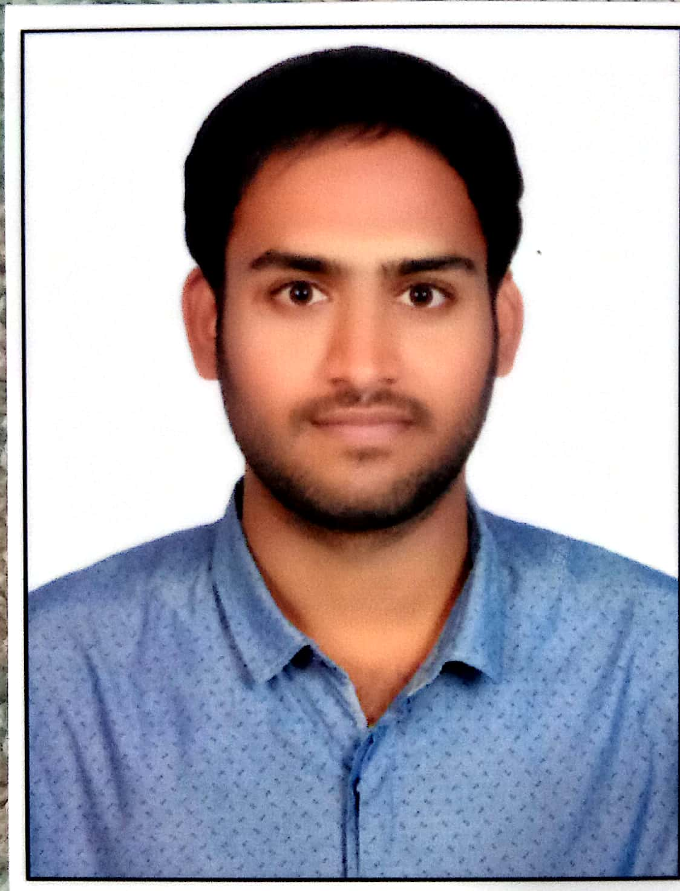
Team Members:
Akhitha Tumula
Mahender Reddy Surkanti
Rethima Reddy Polam
Rohan Goud Bhandari

Slide 3
INTRODUCTION :
Mahender
Rethima
Akhitha
Rohan

Slide 4
ORGANIZATION PROFILE :

